Slide 1
Left Factoring, Left Recursion, First and Follow

Slide 2
Left Factoring
Left Factoring is a grammar transformation technique used to remove common prefixes from productions of a non-terminal.
It is mainly required when:
  Two or more productions of a non-terminal start with the same prefix
  We want to make the grammar suitable for predictive parsing (LL(1))
  To avoid parsing conflicts

Slide 3
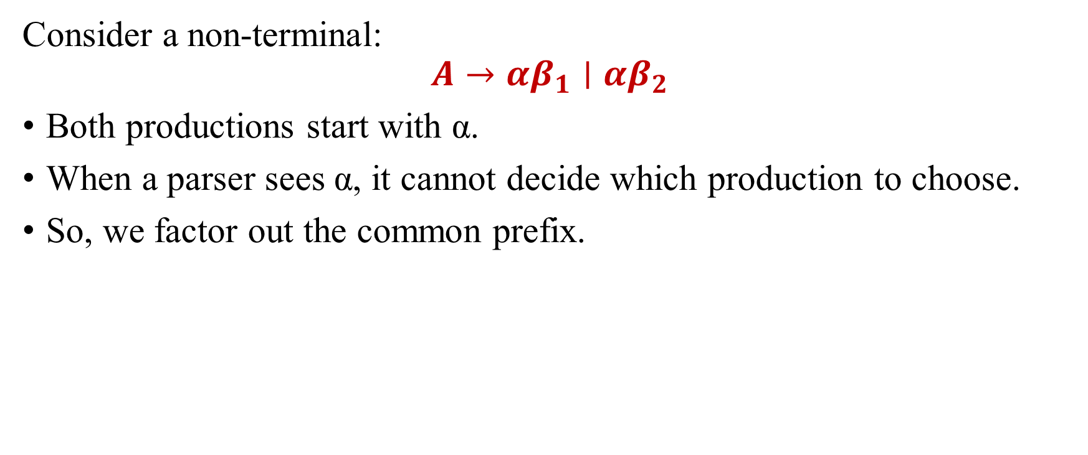
Need for Left Factoring
Consider a non-terminal:
$$A→αβ_{1}∣αβ_{2}$$
Both productions start with α.
When a parser sees α, it cannot decide which production to choose.
So, we factor out the common prefix.

Slide 4

Left Factoring Rule
If:
$$A→αβ_{1}∣αβ_{2}$$
Transform into:
$$A→αA^{′}$$
$$A^{′}→β_{1}∣β_{2}$$

Slide 5
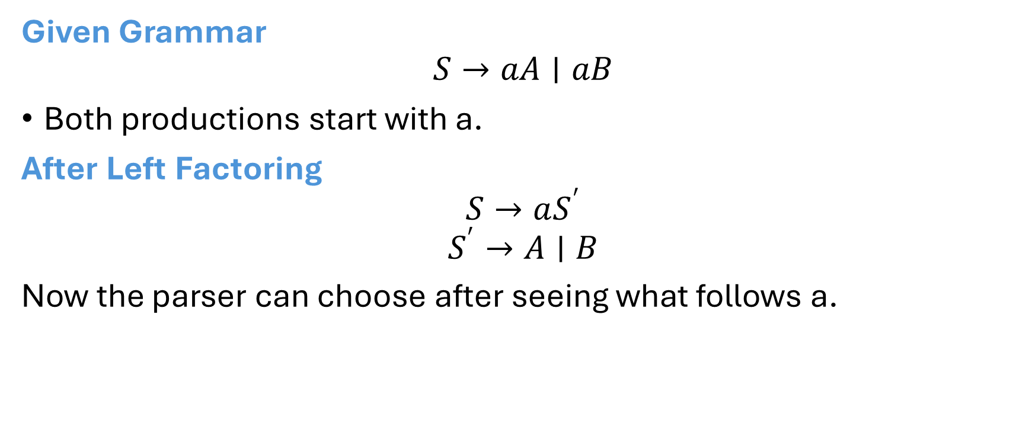
Example
Given Grammar
$$S→aA∣aB$$
Both productions start with a.
After Left Factoring
$$S→aS^{′}$$
$$S^{′}→A∣B$$
Now the parser can choose after seeing what follows a.

Slide 6

Example
Given Grammar
$$A→ab∣ac$$
Common prefix = a
Factor out a
$$A→aA^{′}$$
$$A^{′}→b∣c$$

Slide 7

Example
Given Grammar
$$S→abcD∣abcE∣f$$
Common prefix = abc
Factor abc
$$S→abcS^{′}∣f$$
$$S^{′}→D∣E$$

Slide 8
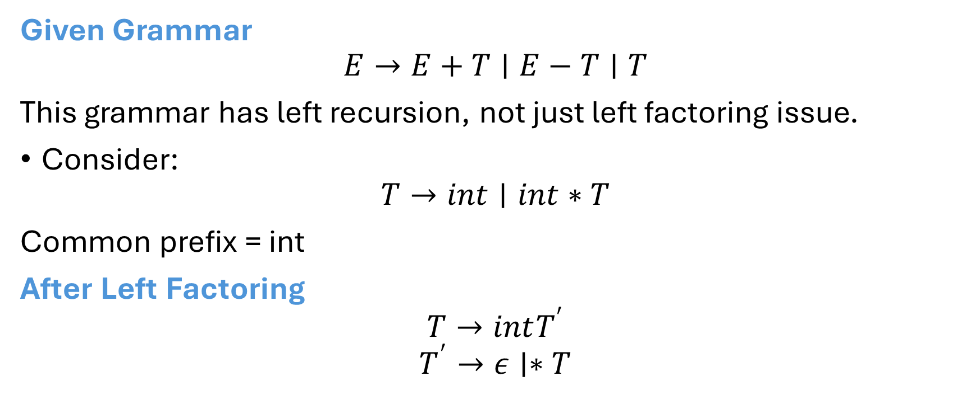
Given Grammar
$$E→E+T∣E−T∣T$$
This grammar has left recursion, not just left factoring issue.
Consider:
$$T→int∣int∗T$$
Common prefix = int
After Left Factoring
$$T→intT^{′}$$
$$T^{′}→ε∣∗T$$

Slide 9
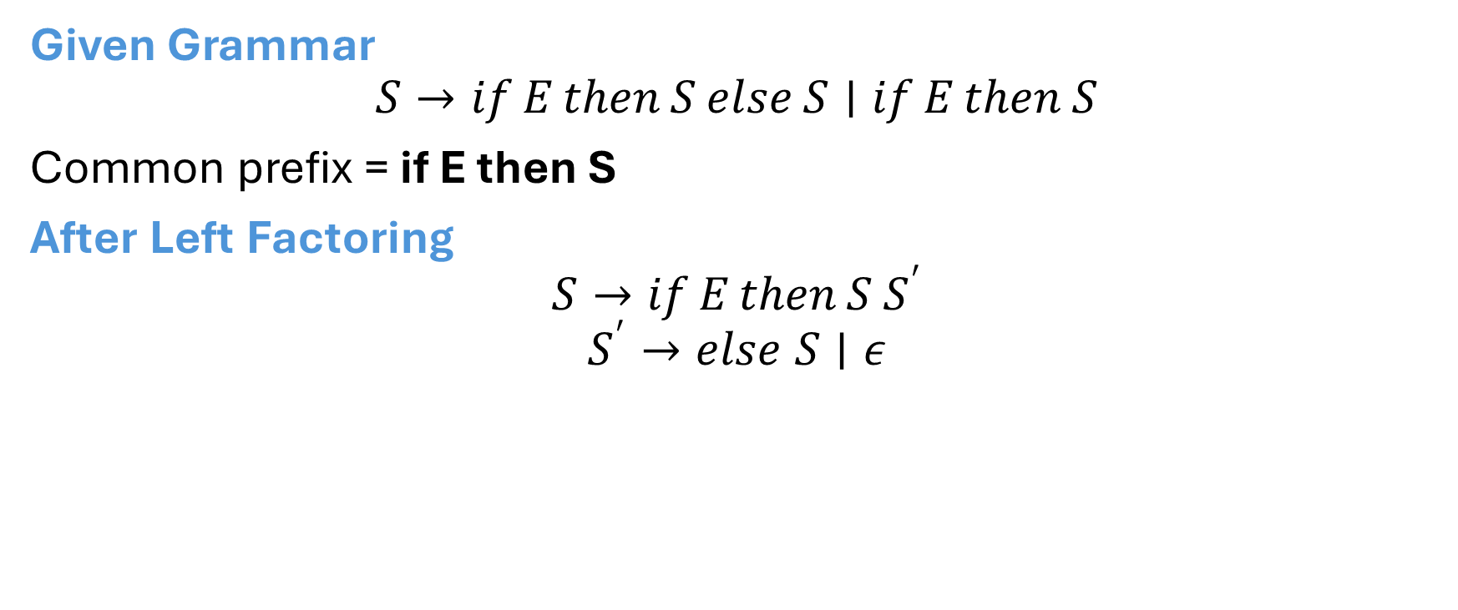
Given Grammar
$$S→if E then S else S∣if E then S$$
Common prefix = if E then S
After Left Factoring
$$S→if E then S S^{′}$$
$$S^{′}→else S∣ε$$

Slide 10
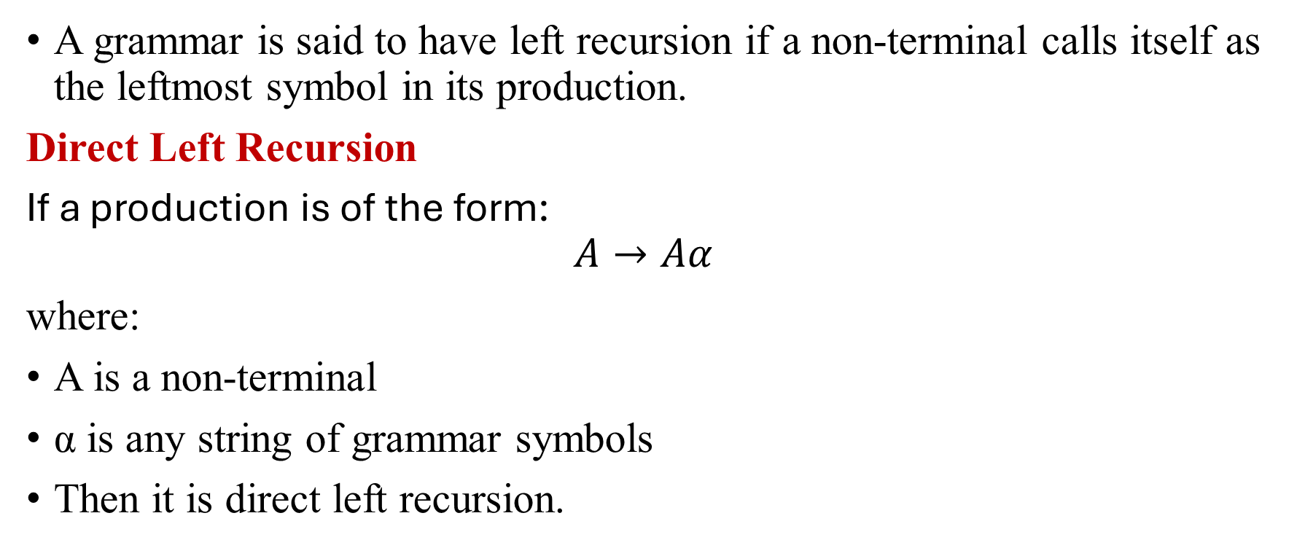
Left Recursion
A grammar is said to have left recursion if a non-terminal calls itself as the leftmost symbol in its production.
Direct Left Recursion
If a production is of the form:
$$A→Aα$$
where:
A is a non-terminal
α is any string of grammar symbols
Then it is direct left recursion.

Slide 11
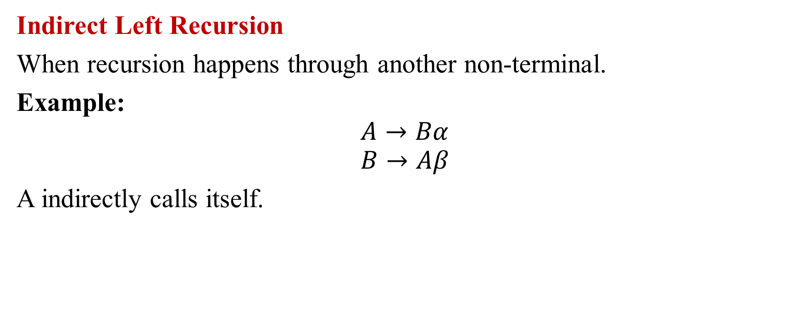
Indirect Left Recursion
When recursion happens through another non-terminal.
Example:
$$A→Bα$$
$$B→Aβ$$
A indirectly calls itself.

Slide 12
Eliminating Left Recursion
It causes infinite recursion in top-down parsing.
Recursive descent parser enters infinite loop.
LL(1) parser cannot be constructed.
We eliminate left recursion to make grammar suitable for:
  Predictive parsing
  LL(1) parsing
  Recursive descent parsing

Slide 13
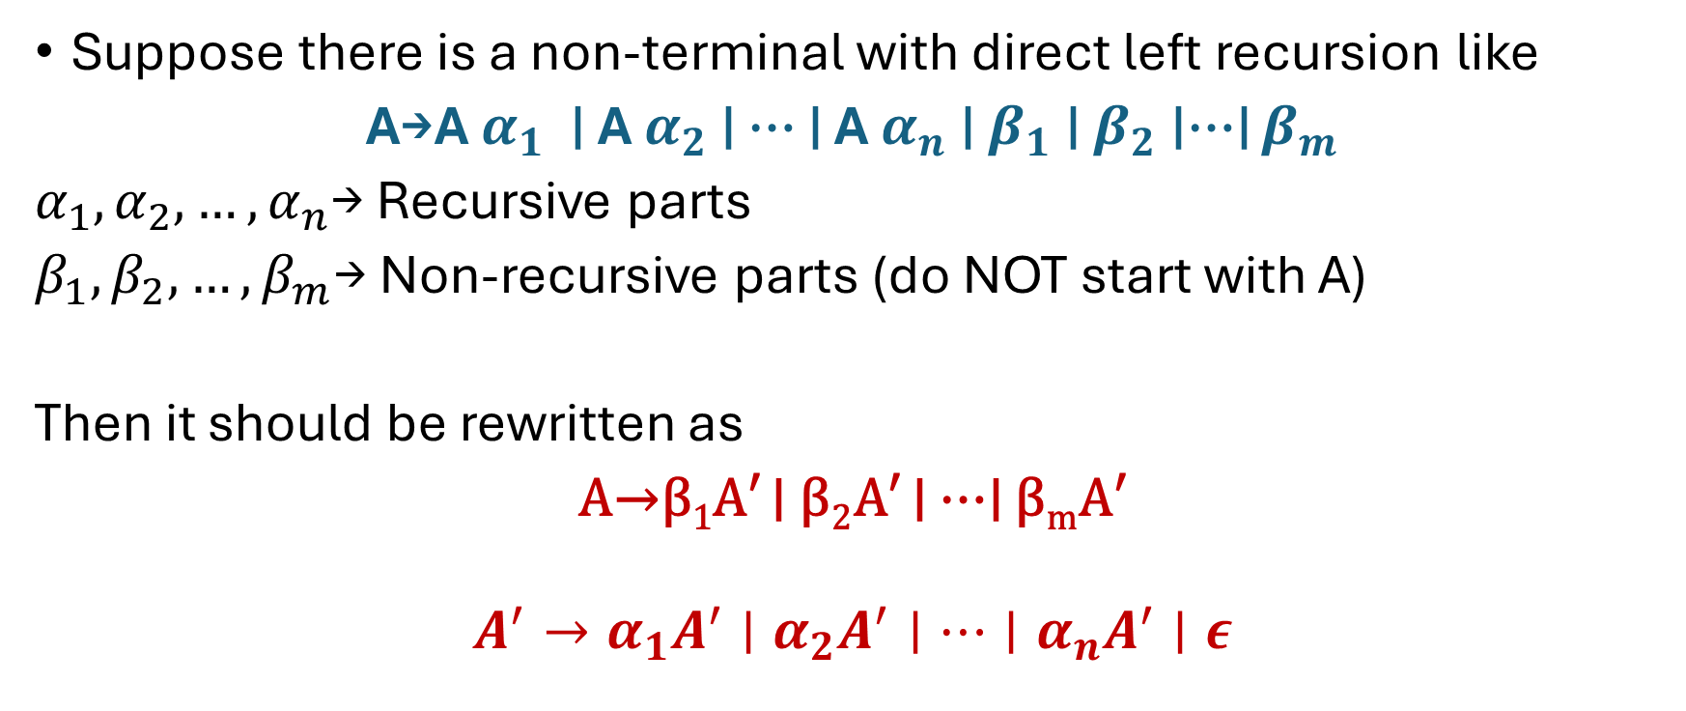
Left Recursion Elimination
Suppose there is a non-terminal with direct left recursion like
A→A $α_{1}$​ ∣ A $α_{2}$ ​∣ ⋯ ∣ A $α_{n}$​∣ $β_{1}$∣ $β_{2}$​∣⋯∣ $β_{m}$
$α_{1},α_{2},…,α_{n}$→ Recursive parts
$β_{1},β_{2},…,β_{m}$→ Non-recursive parts (do NOT start with A)
Then it should be rewritten as
A→β₁​A′ ∣ β₂​A′ ∣ ⋯∣ β_{m}​A′
$$A^{′}→α_{1}A^{′}∣α_{2}A^{′}∣⋯∣α_{n}A^{′}∣ε$$

Slide 14

Examples
1. Remove the left recursion in the following grammar
X - >Xab | Xc | def
X->def X′
X′->ab X′ | c X′ | $ε$

Slide 15

2. Remove the left recursion in the following grammar
X->Xa | Xbc | dXe | fg | h
Answer:
X->dXeX′ | fgX′ | hX′
X′->aX′ | bcX′ | $ε$

Slide 16
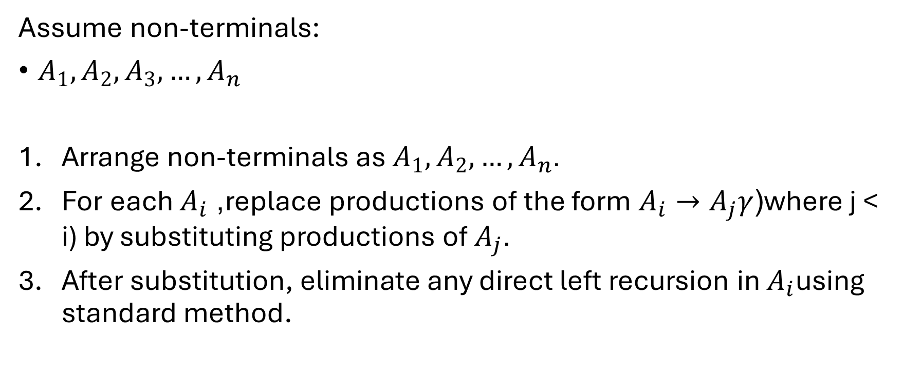
Eliminating Indirect Left Recursion
Assume non-terminals:
$A_{1},A_{2},A_{3},…,A_{n}$
Arrange non-terminals as $A_{1},A_{2},…,A_{n}$.
For each $A_{i}$, replace productions of the form $A_{i}→A_{j}γ$(where j < i) by substituting productions of $A_{j}$.
After substitution, eliminate any direct left recursion in $A_{i}$using standard method.

Slide 17
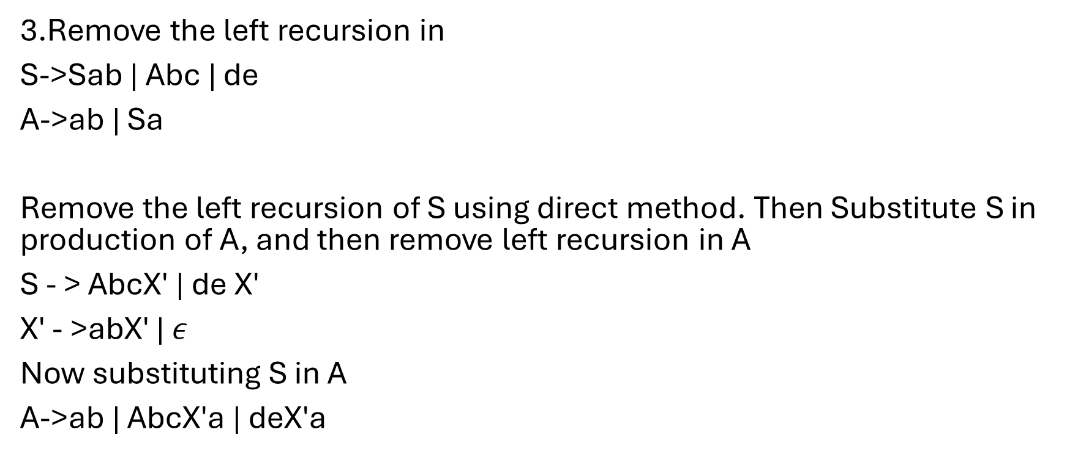
Example
3.Remove the left recursion in
S->Sab | Abc | de
A->ab | Sa
Remove the left recursion of S using direct method. Then Substitute S in production of A, and then remove left recursion in A
S - > AbcX′ | de X′
X′ - >abX′ | $ε$
Now substituting S in A
A->ab | AbcX′a | deX′a

Slide 18

Now removing left recursion of A
A->abY′ | deX′aY′
Y′ ->bcX′aY′| $ε$
Final Rules
S - > AbcX′ | de X′
X′ - >abX′ | $ε$
A->abY′ | deX′aY′
Y′ ->bcX′aY′| $ε$

Slide 19
Left Recursion vs Left Factoring
Left Recursion | Left Factoring
A → Aα | A → αβ₁ / αβ₂
Causes infinite recursion | Causes choice conflict
Remove using recursion elimination | Remove using prefix factoring

Slide 20
First and Follow Sets
FIRST and FOLLOW are two sets used to help parsers understand how to process a grammar.
FIRST Set: The FIRST set of a non-terminal contains all the terminal symbols that can appear at the beginning of any string derived from that non-terminal. In other words, it tells us which terminal symbols are possible when expanding a non-terminal.
FOLLOW Set: The FOLLOW set of a non-terminal contains all the terminal symbols that can appear immediately after that non-terminal in any derivation. It helps identify what can follow a non-terminal in the grammar and is essential for handling productions where a non-terminal is at the end of a rule.

Slide 21
FIRST (X)
The FIRST(X) set is a collection of terminal symbols (and possibly ε) that can appear as the leftmost symbol when we expand X in a derivation of a given grammar.
When X is a terminal:
If X is a terminal symbol (for example, 'a' or 'b'), the FIRST(X) set simply contains X itself, since a terminal always starts with itself.
Example: If X = a, then FIRST(a) = {a}.

Slide 22
When X has only one production rule of type X → aY:
If a non-terminal has a production that begins with a terminal symbol, then the FIRST set contains that terminal symbol.
Example:
A → a B
Here, the FIRST set of A contains the first terminal symbol on the right-hand side.
FIRST(A) = { a }

Slide 23
When X has multiple production rules:
If X is a non-terminal (for example, A or B), the FIRST(X) set includes all the terminal symbols that could be the first symbol of any string derived from X. This means, for each production rule of X, you look at what can be the first symbol of that rule.
Example:
A → a B
A → b
A → ε
Here, FIRST(A) = {a, b, ε} because:
The first symbol in the first production A → a B is 'a'.
The first symbol in the second production A → b is 'b'.
The third production A → ε means A can derive an empty string, so ε is included.

Slide 24
When X is a string of non-terminals:
If X is a string made up of terminals and/or non-terminals (like A B C), we start with the leftmost symbol and use its FIRST set.
To compute FIRST(X), you look at FIRST(A). If A can derive ε (i.e., the empty string), then you also look at FIRST(B), and so on. If both A and B can derive ε, you also need to consider FIRST(C).
Example:
X → A B C
A→a∣ε
B→b∣ε
C→c∣d
The FIRST(X) is {a,b,c,d}.
This is because:
  A contributes a and ε.
  B contributes b and ε.
  C contributes c and d. Since A and B can both derive ε, we include the first symbols of C.

Slide 25
FOLLOW (X)
The FOLLOW(X) set contains all the terminal symbols that can appear immediately after the non-terminal X in any valid string derived from the grammar. It is used in parsing to decide what symbols can follow a particular non-terminal in a derivation.

Slide 26
When X is the start symbol of the grammar:
If X is the start symbol (e.g., S), the FOLLOW(S) set always includes the special end-of-input marker $ to indicate that nothing comes after the start symbol in a complete string.
Example:
Start Symbol = S
FOLLOW(S) = { $ }

Slide 27
When X appears before a terminal:
If X is followed by a terminal symbol in a production rule, that terminal symbol is added to FOLLOW(X).
Example:
A → a B c
Here, B is followed by c, so c is in FOLLOW(B).

Slide 28
When X appears before a non-terminal:
If X is followed by a non-terminal (e.g., B), the FIRST(B) set is added to FOLLOW(X). However, if B can derive ε (empty string), then
FOLLOW(X) include the FIRST of terminal or non-terminal (excluding ε) that is after B.
If there is nothing after B then FOLLOW(X) include the FOLLOW of left-hand side non-terminal of the production rule.
Example:
A → a X B
B → b | ε
If FIRST(B) = {b, ε}, then:
  b is added to FOLLOW(X).
  Since B can derive ε, FOLLOW(A) will also be included in FOLLOW(X).

Slide 29
When X appears at the end of a production rule:
If X appears at the end of a production rule (e.g., A → B X), then FOLLOW(A) is added to FOLLOW(X) because whatever follows A in the string must also follow X.
Example:
A → B X
Here, everything in FOLLOW(A) must also be included in FOLLOW(X).

Slide 30
Examples
1. Derive First and Follow Sets for S→ε
First(S) = {ε}
Follow(S)={$} Since S is the start symbol
2. Derive First and Follow Sets for S →aSb| ε
First(S)={a, ε}
Follow(S)={$,b}

Slide 31
Examples
3. Derive First and Follow Sets for
    S →bA | a
    A-> aSb | Ad | f
First(S)={b,a}
First(A)={a,f}
Follow(S)={$,b}
Follow(A)={d} union Follow(S) = {d, $,b}

Slide 32
Examples
4. Derive First and Follow Sets for
  S->Sa | Sb | ε
First(S) = {ε, a, b}
Follow(S) = {$, a, b}

Slide 33

Examples
5.Derive First and Follow Sets for
S→ABC
$A→aA∣ε$
$B→bB∣ε$
$C→cD∣ε$

Slide 34
Examples
FIRST(S)={a,b,c,ϵ}
FIRST(A)={a,ϵ}
FIRST(B)={b,ϵ}
FIRST(C)={c,ϵ}
FOLLOW(S)={$}
FOLLOW(A)={b,c,$} [A is followed by BC, Compute First(BC)
Strart with First(B), since ε ∈ FIRST(B), check C. Include FIRST(C), Since ε ∈ FIRST(C), include FOLLOW(S)
FOLLOW(B)={c,$} [B is followed by C, include First (C),without ε. Since ε ∈ FIRST(C), add FOLLOW(S)]
FOLLOW(C)={$} [C is at end of production. FOLLOW(C)=FOLLOW(S) ]

Slide 35

Example
6. Determine First and Follow Sets for
E→TR
$R→+TR∣\#$
$T→FY$
$Y→∗FY∣\#$
$F→\left(E\right)∣i$

Slide 36
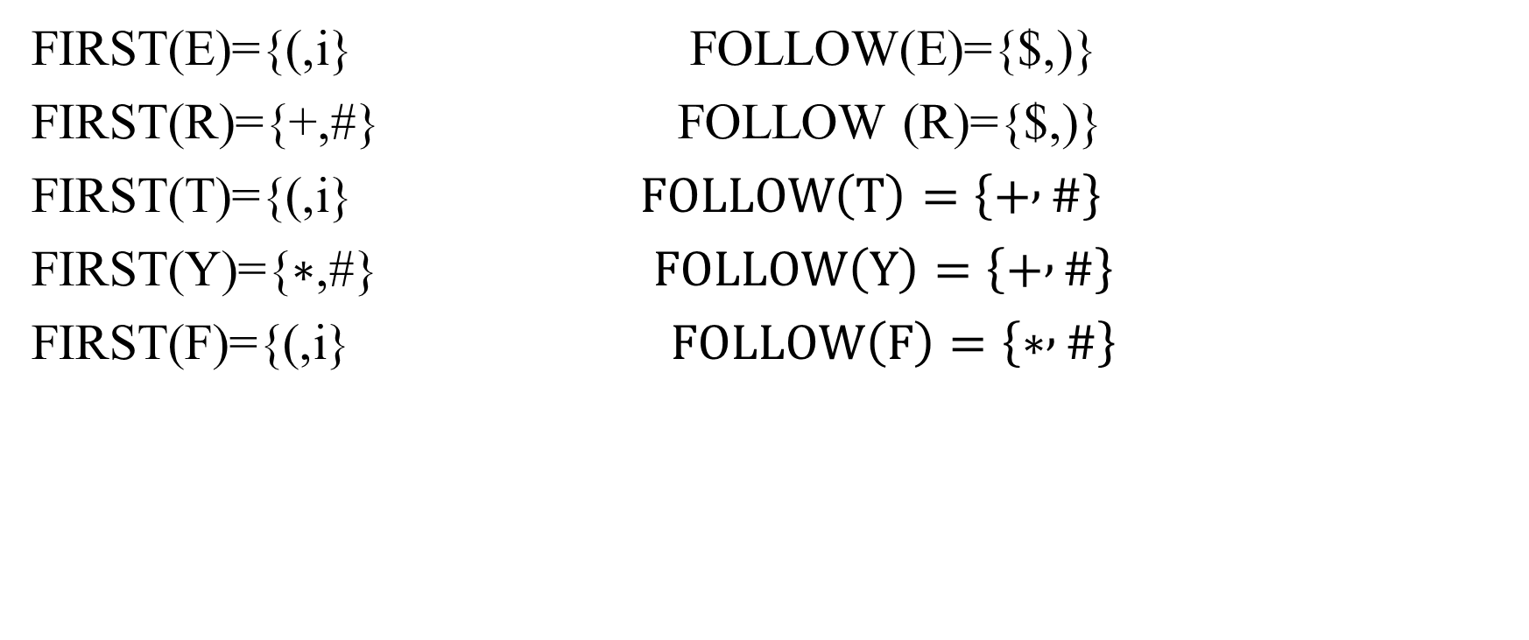
FIRST(E)={(,i} FOLLOW(E)={$,)}
FIRST(R)={+,#} FOLLOW (R)={$,)}
FIRST(T)={(,i} $FOLLOW\left(T\right)=\left\{+ , \#\right\}$
FIRST(Y)={∗,#} $FOLLOW\left(Y\right)=\left\{+ , \#\right\}$
FIRST(F)={(,i} $FOLLOW\left(F\right)=\left\{∗ , \#\right\}$

